Slide 2

Project 3: Law-based and document-based chatbot
Trieu Kinh Quoc | 20225524

Slide 3
Table of contents
1. Problem Definition
2. System Design
3. Updated Progress
4. Upcoming Work
5. Live Demo

Slide 4
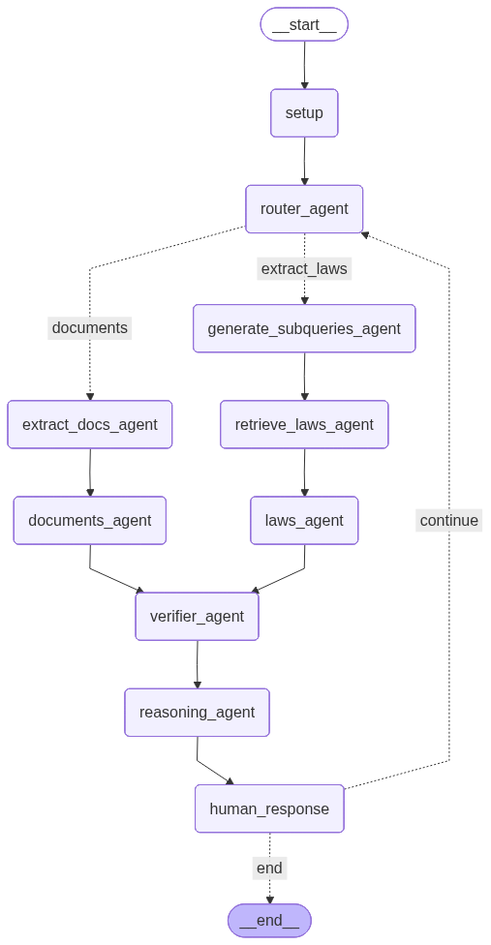
1. System Design
Framework:
- Vector Embedding: HuggingFace
- Vector Database: FAISS
- Document Extraction: PDFReader
- LLM (API Used): LangChain
- Multi-Agent System Building: LangGraph

Slide 5
2. Updated Progress
- Added two agents:
Verifier agents: Verify the answers (if it contains sensitive contents,...)
Reasoning agents: Explain the system’s response
- Evaluated the system:
Agent Performance:
DeepEval Framework
Precision, Recall, Mean Reciprocal Ranking,...
Agent Processing Time:
Each Agent’s Average Processing Time
Total System Processing Time

Slide 6

2. Updated Progress
DeepEval Framework:
- An open-source LLM evaluation framework, for evaluating and testing large-language model systems.
- Used LLM-as-a-judge mechanism
- Custom NLP Models for evaluation
- Designed different metrics for each components in the system:
DAG
RAG
Agentic Metrics
Other metrics: Hallucination, Task Completion, etc.

Slide 7
2. Updated Progress (Model Evaluation)
Router Agent:
- Dataset to test:
1000 queries from: legal questions (test dataset)
1000 queries from: UIT ViQUAD2.0: dataset hỏi đáp tiếng Việt (test dataset)
- Metrics used:
Precision
Recall
F1 (per class)
Accuracy (true classification/ total classification)

Slide 8
2. Updated Progress (Model Evaluation)
Method | Accuracy | Documents |  |  | Extract laws
 |  | precision | recall | f1 | precision | recall | f1
Matching based router | 0.55 | 0.53 | 0.92 | 0.67 | 0.7 | 0.18 | 0.28
Classifier based router (in use) | 0.97 | 0.96 | 0.99 | 0.97 | 0.99 | 0.96 | 0.97
Prompt based router | 0.54 | 0.52 | 0.95 | 0.67 | 0.73 | 0.13 | 0.22
Embedding similarity router | 0.98 | 1.00 | 0.97 | 0.98 | 0.97 | 1.00 | 0.98

Slide 9
2. Updated Progress (Model Evaluation)
Generate SubQuery:
- Dataset to test: (to generate the subqueries of the questions)
1000 queries from: legal questions (test dataset)
- Metrics used:
Relevance (Cosine Similarity): If the generated queries relate to the original queries.
Query Coverage (GEval Framework): Evaluate if the generated queries cover all aspects of original query (score range from 0 => 1)
Generate Subquery |  | Note
Relevance (cosine similarity) | 0.93 | Run all 1000 samples
GEval score (query coverage) | 0.9 | Run 20 random samples

Slide 10
2. Updated Progress (Model Evaluation)
Extract Laws Agent:
- Dataset to test: (to generate the subqueries of the questions)
- Metrics used:
Mean Reciprocal Ranking
Precision
Recall
Mean Precision
Extract Laws Agent |  | Note
Mean Reciprocal Ranking
Precision
Recall
Mean Precision

Slide 11
2. Updated Progress (Model Evaluation)
Laws Answer Agent:
- Dataset to test: (to generate the subqueries of the questions)
5 random samples from: Vietnamese Legal QA - HuggingFace (test dataset)
laws_context
question - answer pairs (question - expected_output)
- Metrics used (DeepEval):
Faithfulness metrics: if the generated output (actual_output) really matches with the laws_context.
Correctness metrics: if the generated output (acutal_output) matches with the expected_output
Laws Answer Agent
Faithfulness score | 1
Correctness score | 0.88

Slide 12
2. Updated Progress (Model Evaluation)
Extract Docs Agent:
- Dataset to test: (to generate the subqueries of the questions)
10 question-answer pairs with context related to 10 long, collected pdf-files in multi-topics:
question
answer
list of pdf-files
- Metrics used (DeepEval):
ContextualPrecisionMetric: the portion of information in the extracted context (from agent) that is actually used to get answer.
ContextualRecallMetrics: if all the answer’s information can be taken from extracted context (from agent)
Extract Docs Agent
Context_recall | 0.87
Context_precision | 0.95

Slide 13
2. Updated Progress (Model Evaluation)
Docs Answer Agent:
- Dataset to test: (to generate the subqueries of the questions)
10 random samples from: UIT ViQUAD2.0: dataset hỏi đáp tiếng Việt (test dataset)
docs_context
question - answer pairs (question - expected_output)
- Metrics used (DeepEval):
Faithfulness metrics: if the generated output (actual_output) really matches with the docs_context.
Correctness metrics: if the generated output (acutal_output) matches with the expected_output.
Docs Answer Agent
Faithfulness score | 1
Correctness score | 0.34

Slide 14
2. Updated Progress (Model Evaluation)
Average time’s Processing within each agent:
Agent | Average Processing Time
Router Agent | 0.04s/query*
Generate Subqueries Agent | 4.64s/query
Extract Laws Agent | 0.28s/query*
Laws Answer Agent | 6.99s/query
Extract Docs Agent | 0.16s/query*
Docs Answer Agent | 2.20s/query
*: Not include the first query (need to initialize the model or the index from .index file or uploaded files => cache mechanism for next queries)

Slide 15

3. Upcoming Work

Slide 16
4. Live Demo

Slide 17
THANK YOU !

